Slide 1
DS
Standard Template Library: Now that we know about Overloaded Operators

Slide 2
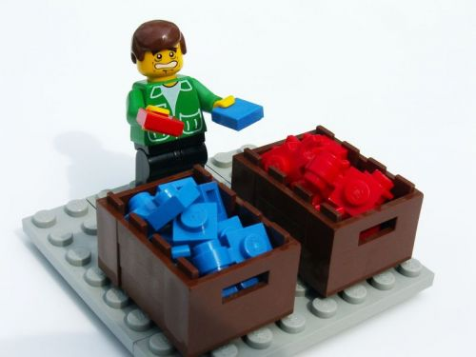
Remember ...
Associative containers are sorted according to the characteristics of the items contained within them
Example: storing words, sorted alphabetically
Notes:
http://blog.pagerduty.com/wp-content/uploads/sorting-lego.jpg

Slide 3

You need to have some way of comparing the items to allow for the sorting
Notes:
http://www.roammobility.com/media/wysiwyg/D1/apples-to-oranges.jpg

Slide 4

Value Comparisons
You must be able to compare the items you are storing in the set
The default comparison is less (a.k.a. operator<)
Notes:
http://mathsticks.com/userfiles/isLessThanImg.jpg

Slide 5

If you are storing primitive data types, less already exists
If you are storing classes, operator< must exist as an overloaded operator
Notes:
http://artifactproductions.ca/fantome/stills/A-2_Film-title_Operator.jpg

Slide 6
You can specify any comparator that you want, as long as you realize that it will treat it like less

Slide 7
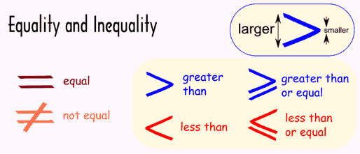
Specifying the comparator
If you don’t want to use the default, pass it as an additional parameter.
Notes:
http://www.mathsisfun.com/definitions/images/inequality.gif

Slide 8

e.g. set<int, greater<int> > collection;
Note: don't put the two '>' operators right next to each other
Notes:
http://dribbble.s3.amazonaws.com/users/56251/screenshots/943814/greater_than.jpg

Slide 9
Classes in Associative Containers
Can put your classes in associative containers
IF
the class has a
bool operator<(T a, T b)
or
you must explicitly state the comparator

Slide 10
Creating your own comparator
http://stackoverflow.com/questions/5733254/create-an-own-comparator-for-map

Slide 11

Hmmm ... Why Do We Need Only One comparator?
You can find out everything you need to know about comparison of the items with one comparator
Notes:
https://encrypted-tbn1.gstatic.com/images?q=tbn:ANd9GcTS-di4f-GQ61zICD6FmEmFoqpRzR8UuKnQ-OnOyOF0fB4cgwuNbg

Slide 12

Let’s assume that you know how to do “less-than” ...
Notes:
https://encrypted-tbn3.gstatic.com/images?q=tbn:ANd9GcS40i05604BiTMGK_pnOMDdNin5jw7SADfqcAtuLWDsWxzgxQ6u

Slide 13

“equal-to” is simply:
if( ! ((e1 < e2) ||
(e2 < e1)) )
Notes:
http://kswptim.files.wordpress.com/2011/04/surprise.jpg

Slide 14

And, if it’s not “less-than” and it’s not “equal-to”, then it must be “greater-than”!!
Notes:
http://www.momgetsalife.com/wp-content/uploads/2012/10/LUCY.jpeg

Slide 15

And that’s why you only need
ONE
overloaded operator!
Notes:
http://www.dpccars.com/gallery/var/albums/Overloaded-Motorcycle/Overloaded%20Motorcycle%20-%2004.jpg?m=1375403831

